Slide 1
Hope Sanctuary COSC 484: Web Engineering
Noor AlArab, Rawan Albinzayed & Dana Barhoom

Slide 2
Table of contents
01
02
03
Introduction
Authentication
Frontend
04
05
06
Backend
Unit Testing
Deployment
Pages, tehcnology stack and strcuture.
About the different roles
React, HTML and APIs
Express and MongoDB
Unit tests with Jest
Deployment method and live demonstration

Slide 3
Introduction
Hope Sanctuary is a pet adoption website used to facilitate the adoption process of animals in shelters or adoption agencies.
The website allows the users to view the animals available for adoption and to submit online adoption forms for pets.
The website also allows employees of the shelter or to add, remove or edit available animals as well as view adoption applications.

Slide 4
User Requirements And Features
The user:
Be able to view available pets.
Be able to submit adoption request.
Be able to submit contact forms.
The admin:
Add, edit and delete available pets.
View all user requests and change status of requests.
User Authentication and Management
Navigation and State Management
Database and API integration
Searching features

Slide 5
Technology Stack
Frontend:
Framework: React.js
Styling: CSS and Bootstrap 5
Backend:
Framework: Express.js
Database: MongoDB
API: RESTful API
Unit Testing: Jest
Deployment: AWS (Amazon Web Services)

Slide 6
The Pages
Home page
Adopt page
AboutUs page
ContactUs page
Login page
SignUp page
Pets page
PetsDetails page
Requests page
Admin page
AddPet page
EditPet page

Slide 7
Authentication
Normal User
Admin
Not Logged in
Can submit adoption form.
Cannot access admin only pages.
Show login link in nav bad.
If logged in, it changes to logout link.
Can access admin dashbaord to add, update and delete pets.
Can view all adoption requests and change status.

Slide 8
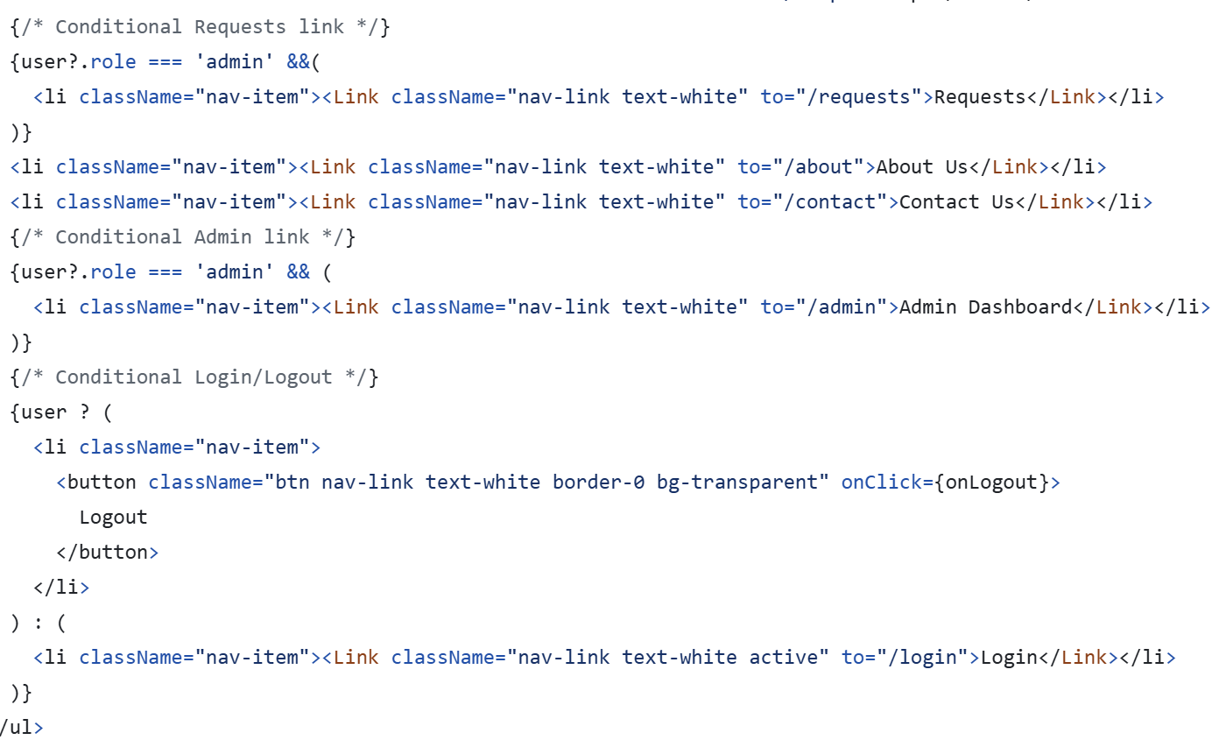
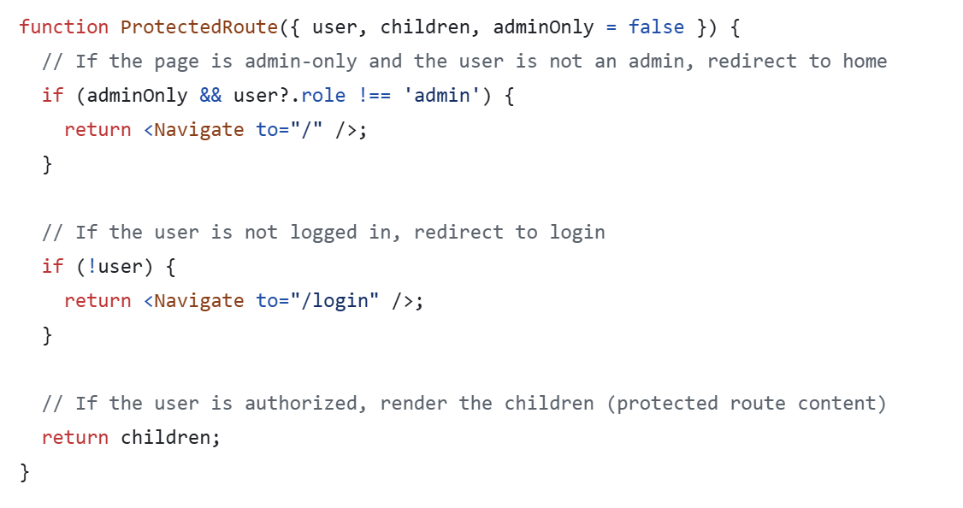
Authentication
In navigation bar:
In routing:

Slide 9
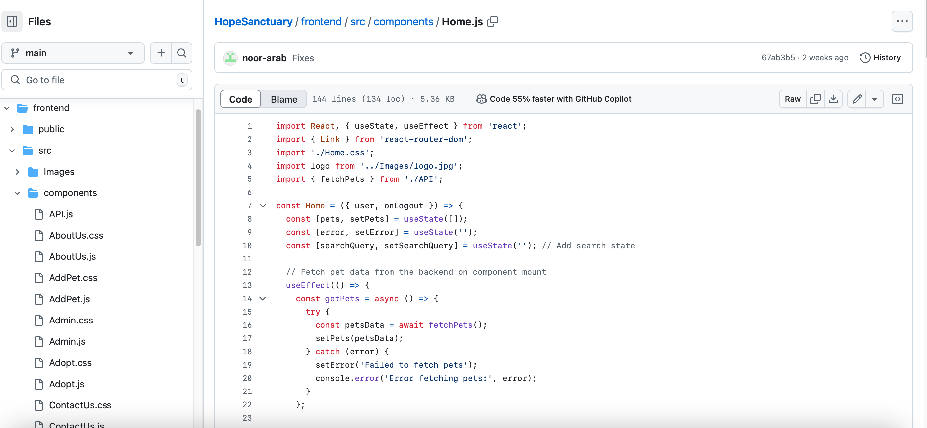
Frontend Structure

Slide 10
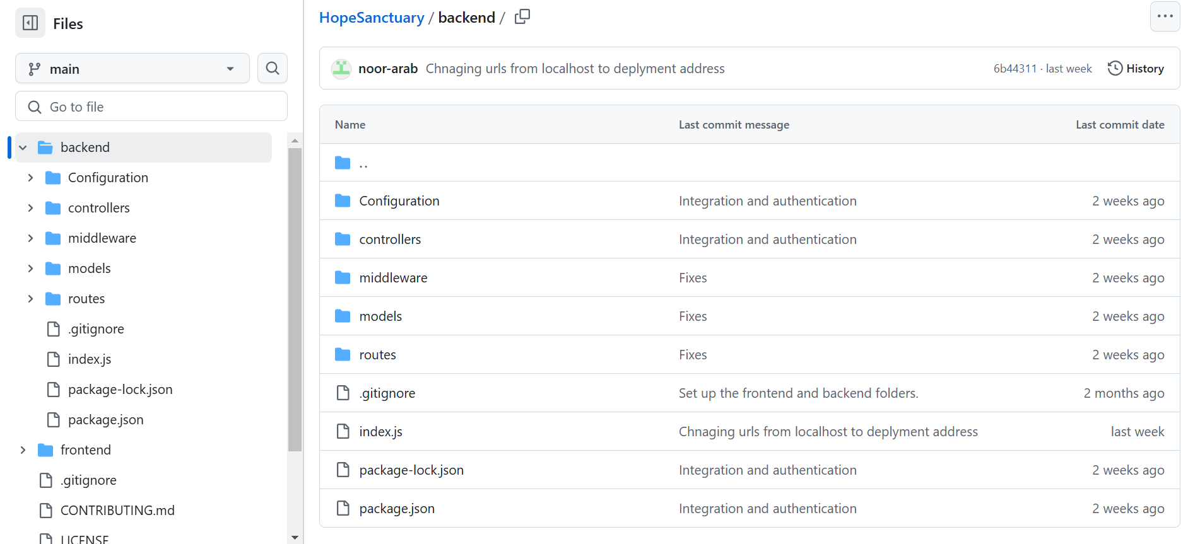
Backend structure

Slide 11
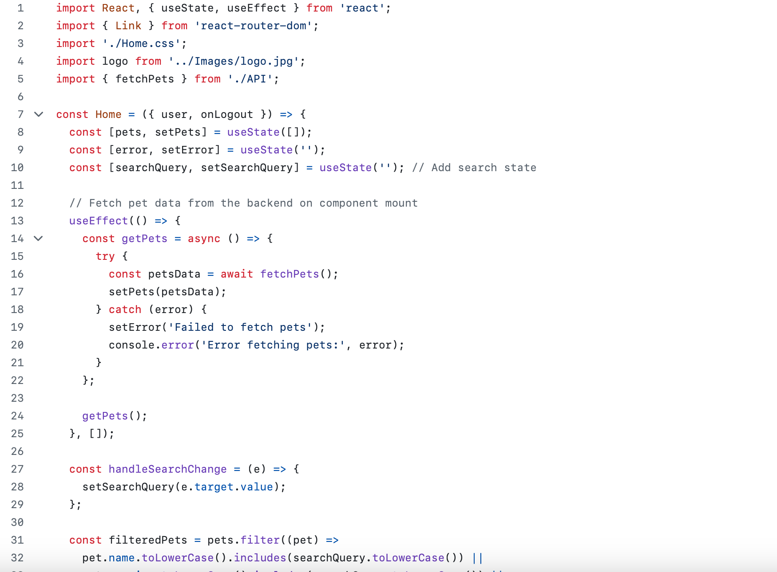
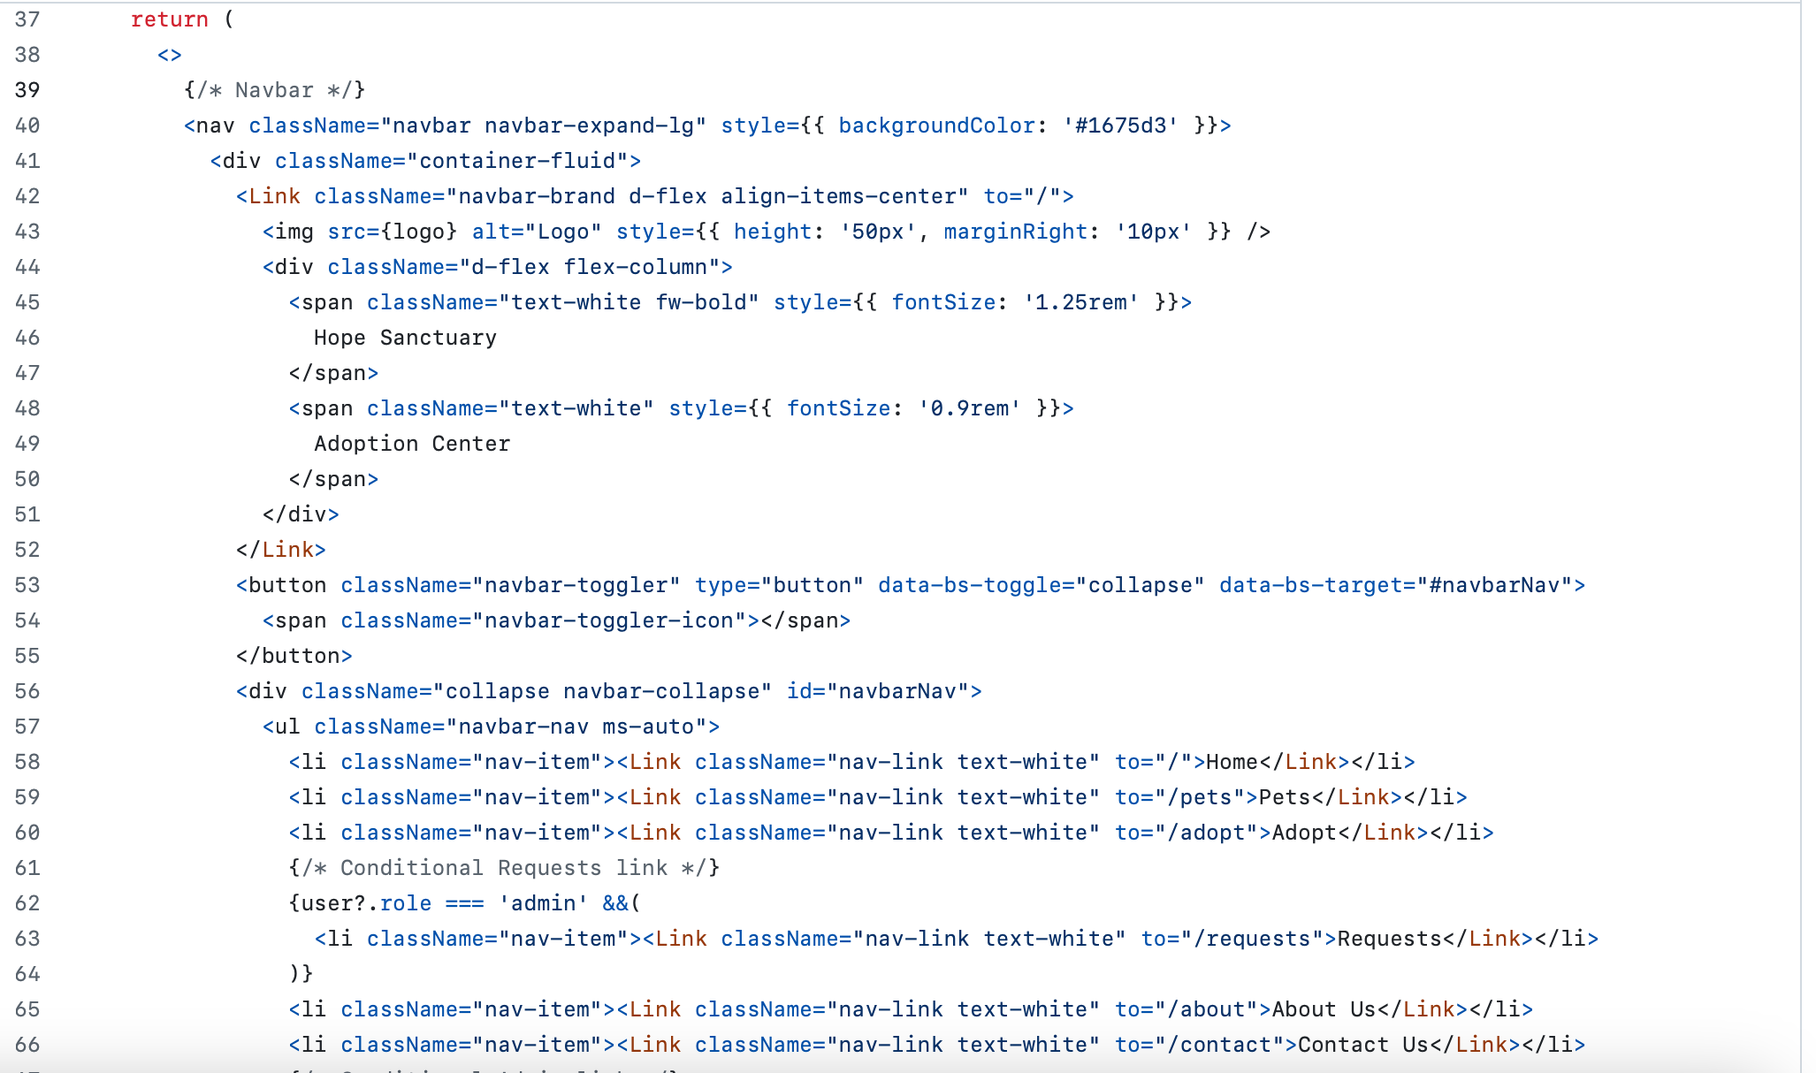
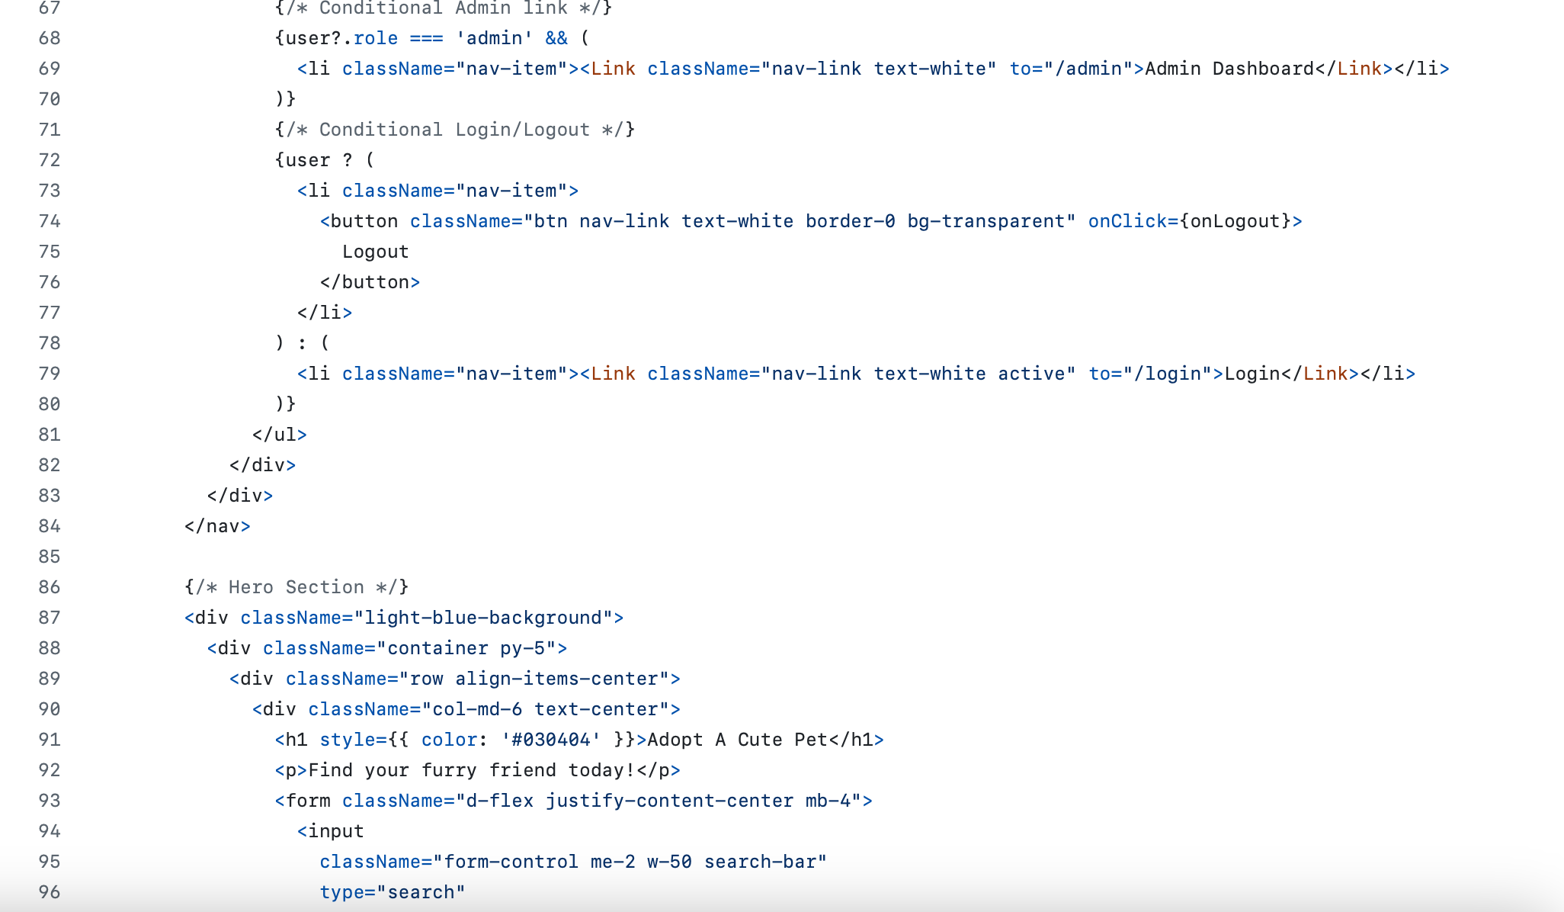
Home Page.js React

Slide 12
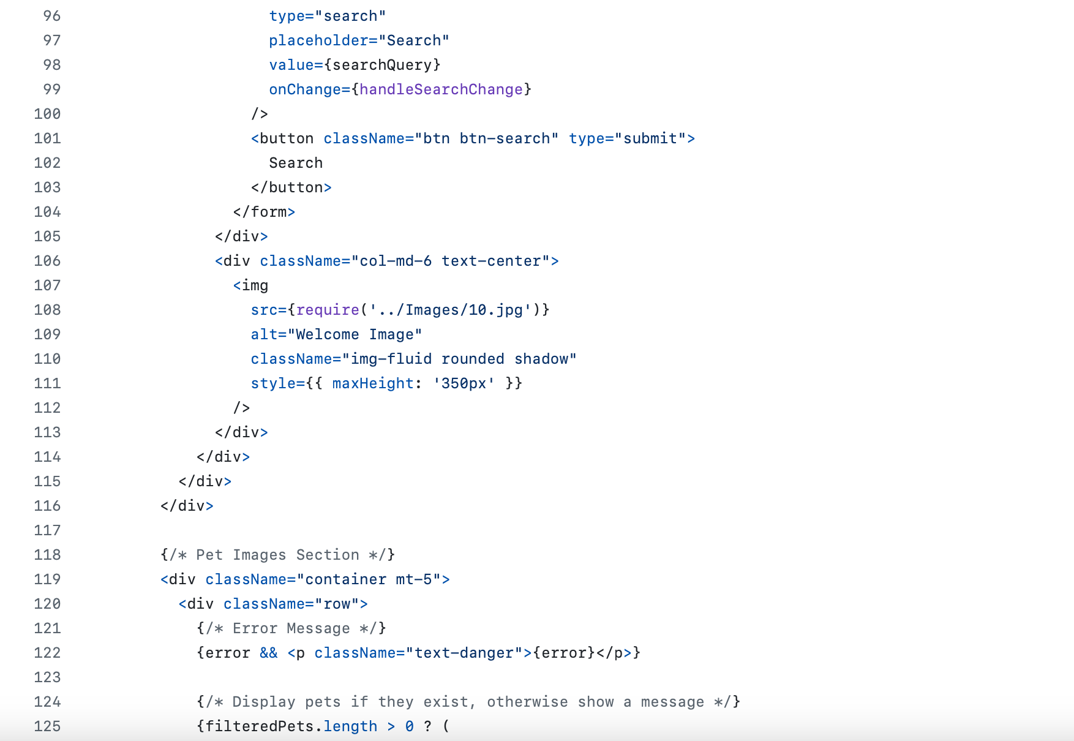
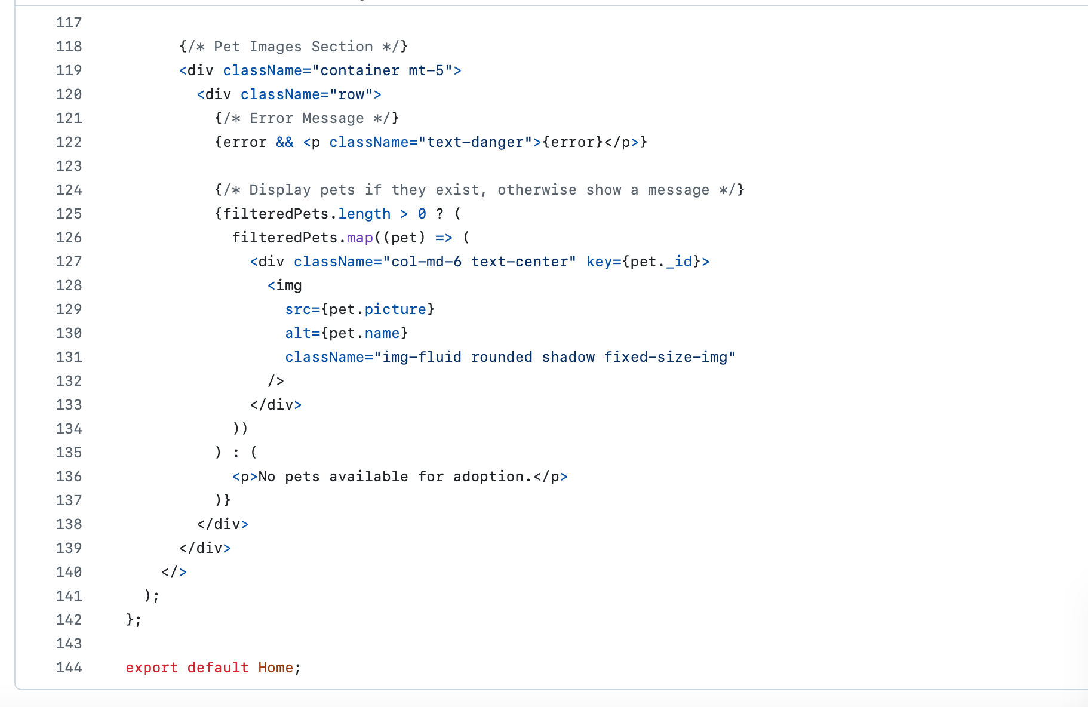
Home Page.js React

Slide 13
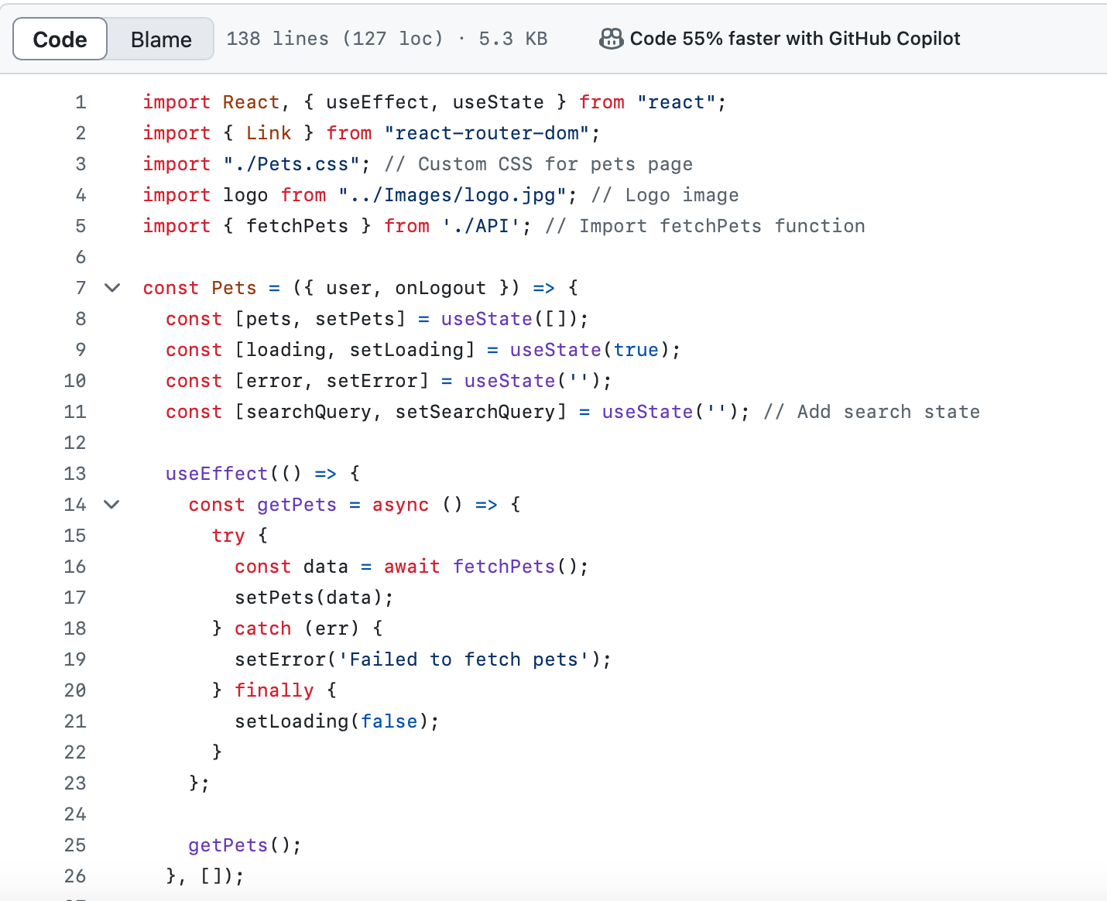
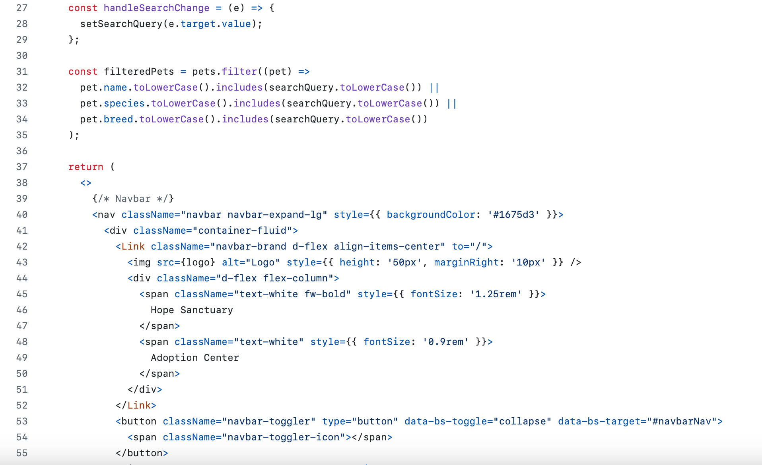
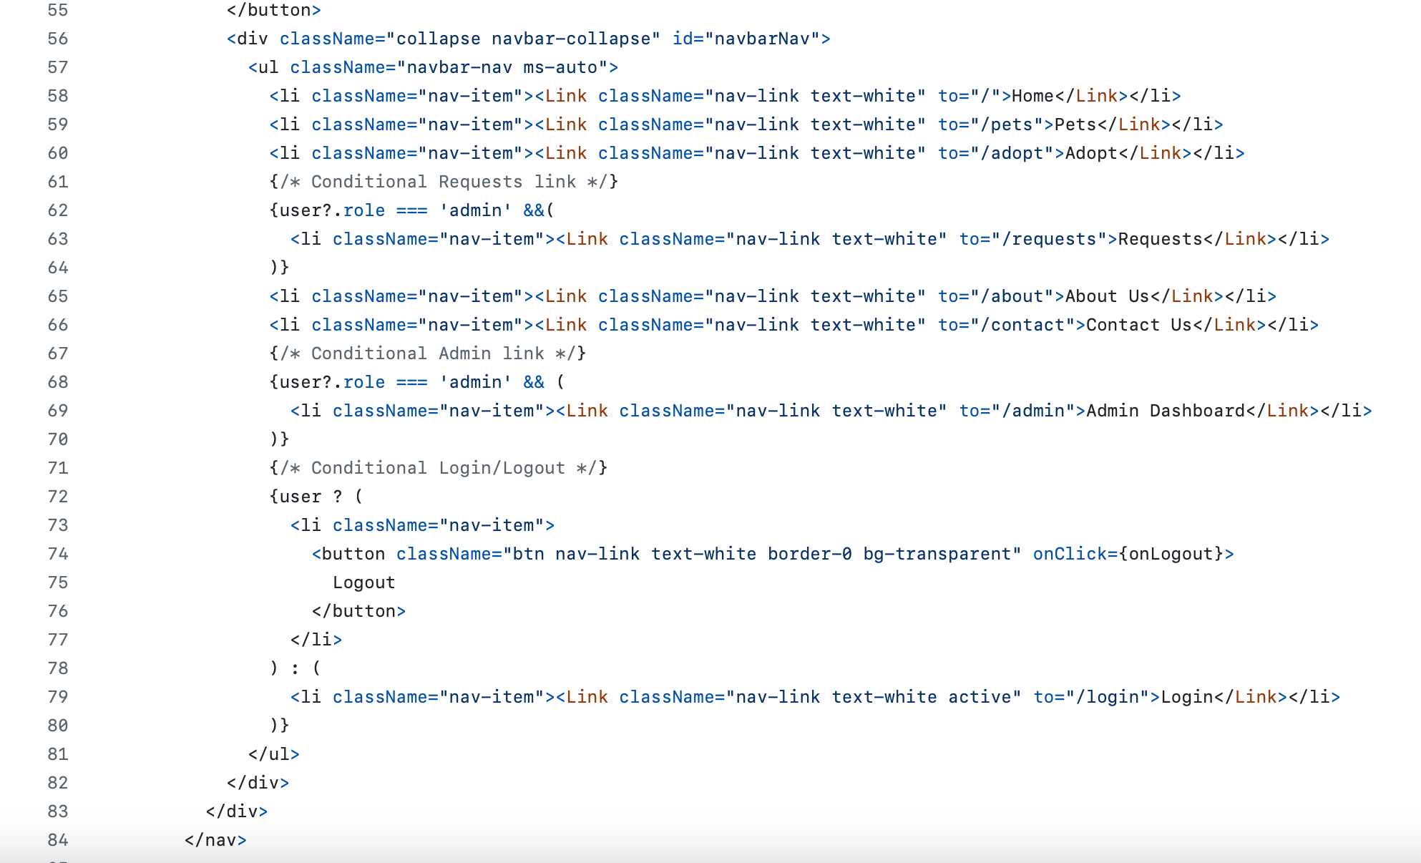
Pet's Page React

Slide 14
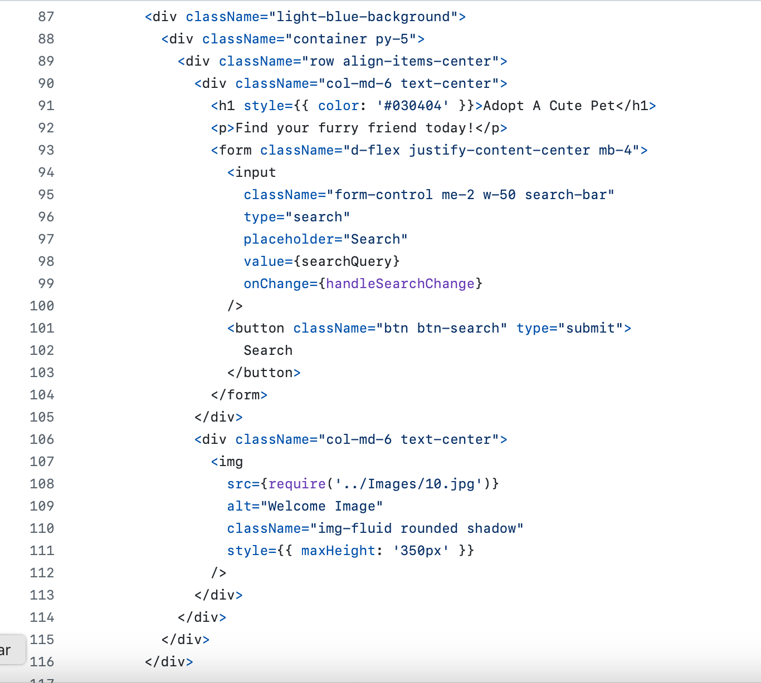
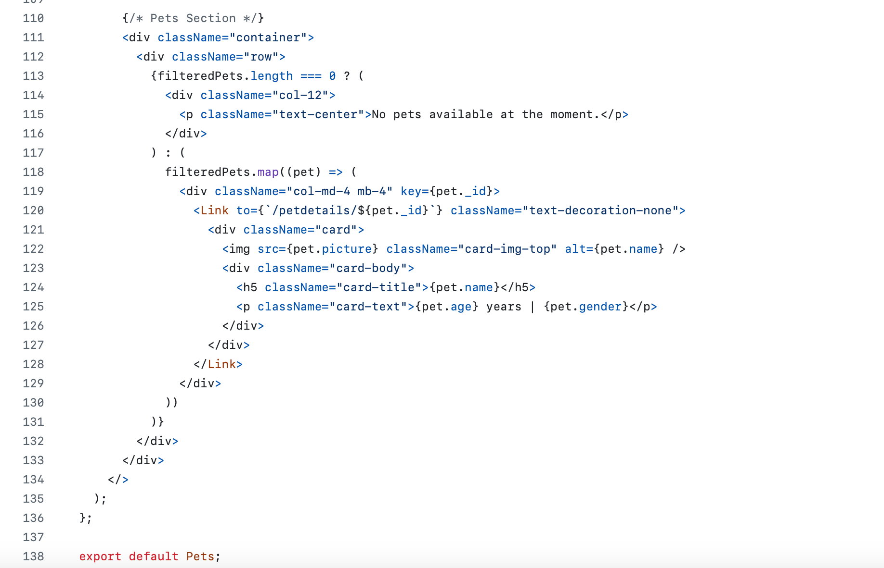
Pet's Page React

Slide 15
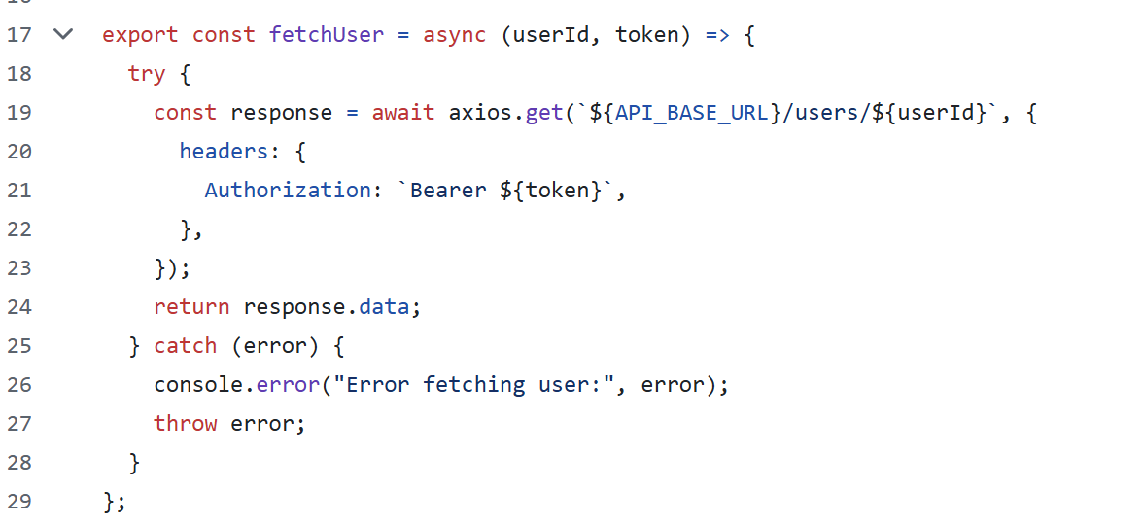
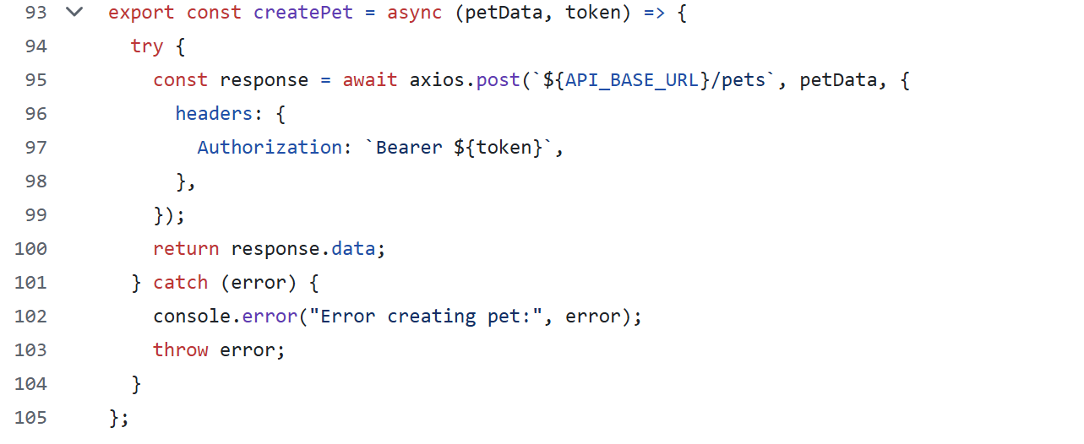
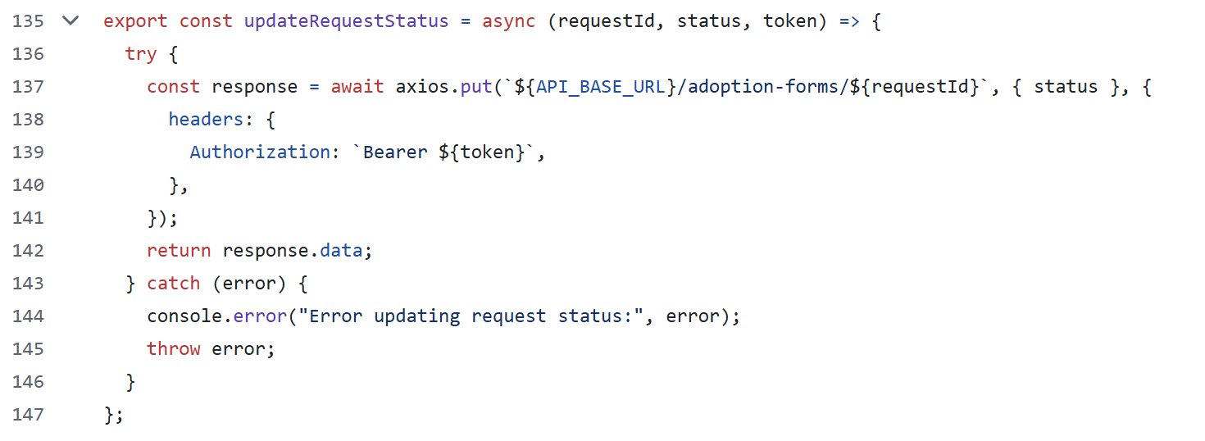
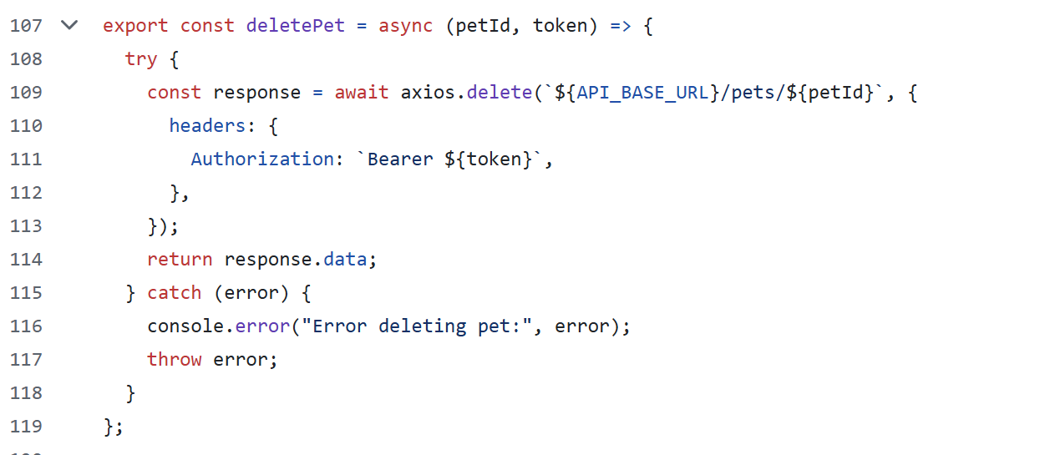
APIs
GET:
POST:
PATCH:
DELETE:

Slide 16
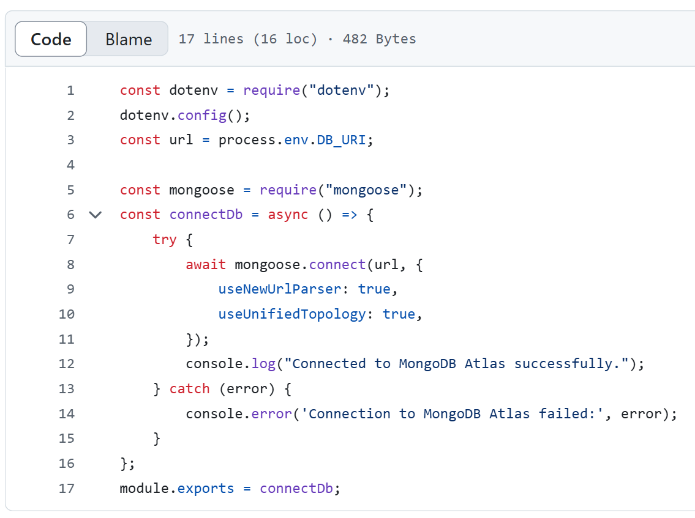
Configuration Code connectDb.js

Slide 17
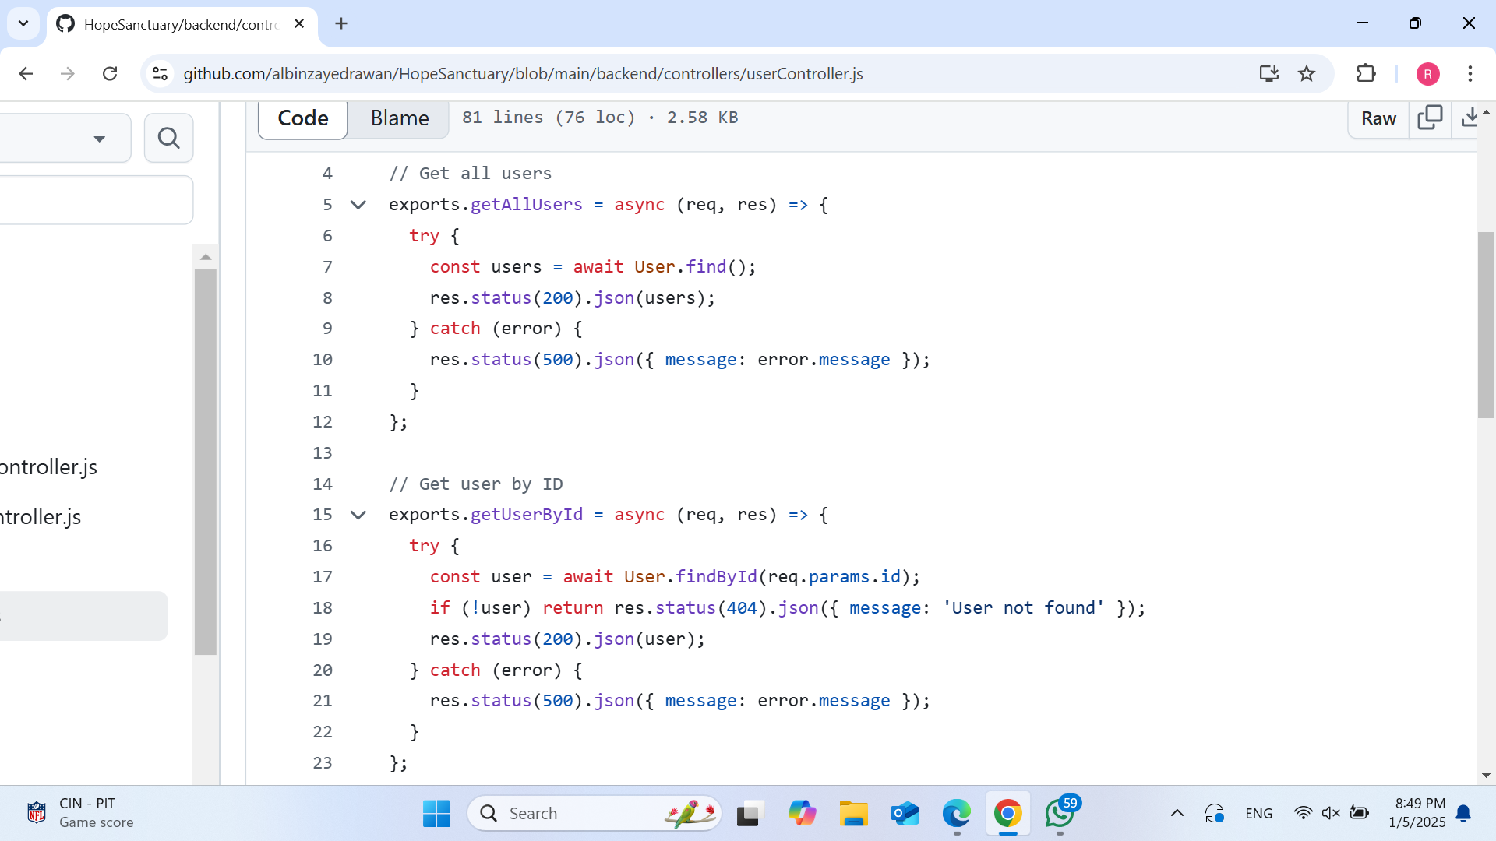
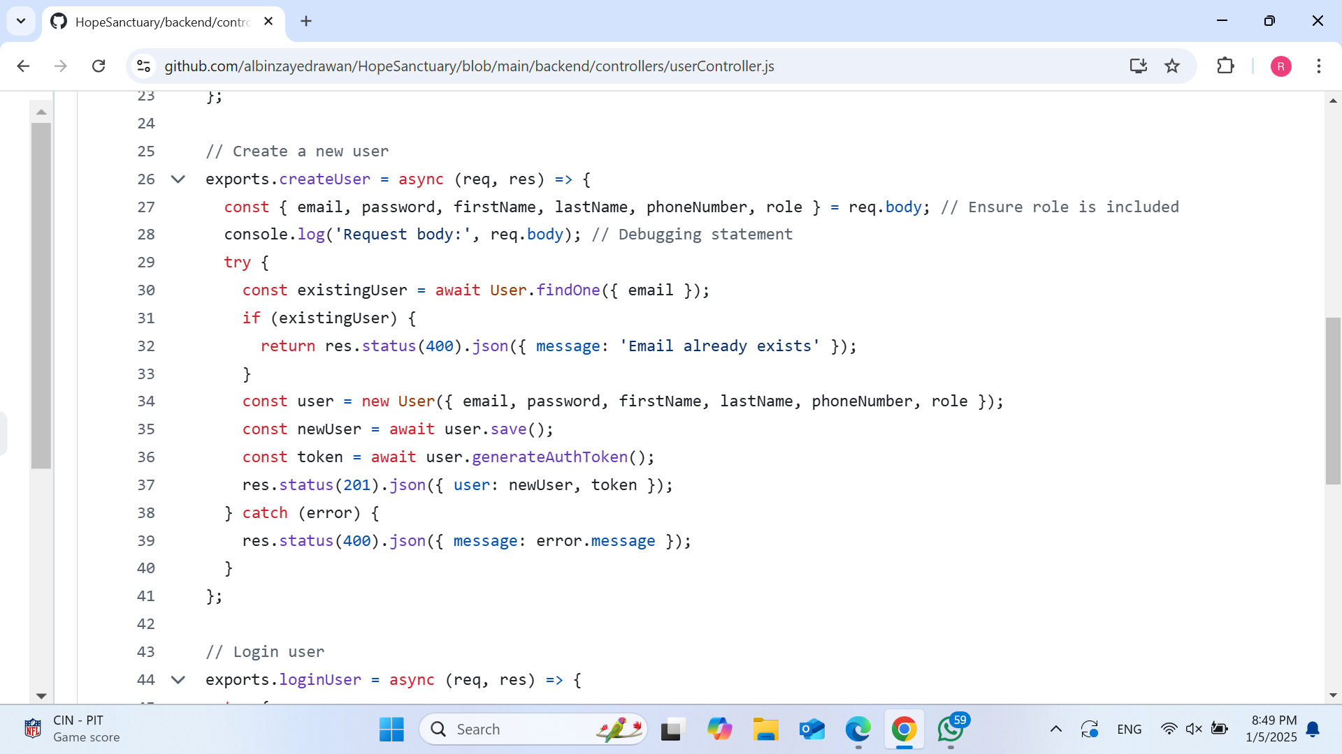
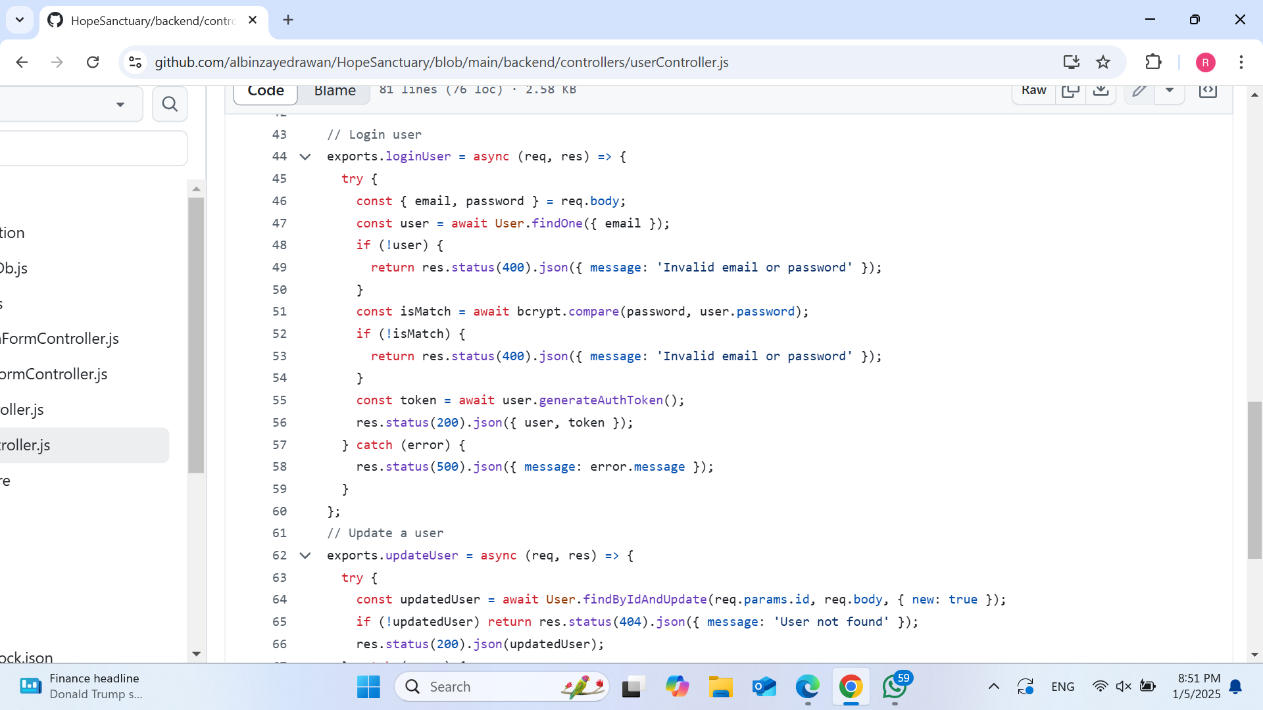
Controllers Code userController.js

Slide 18
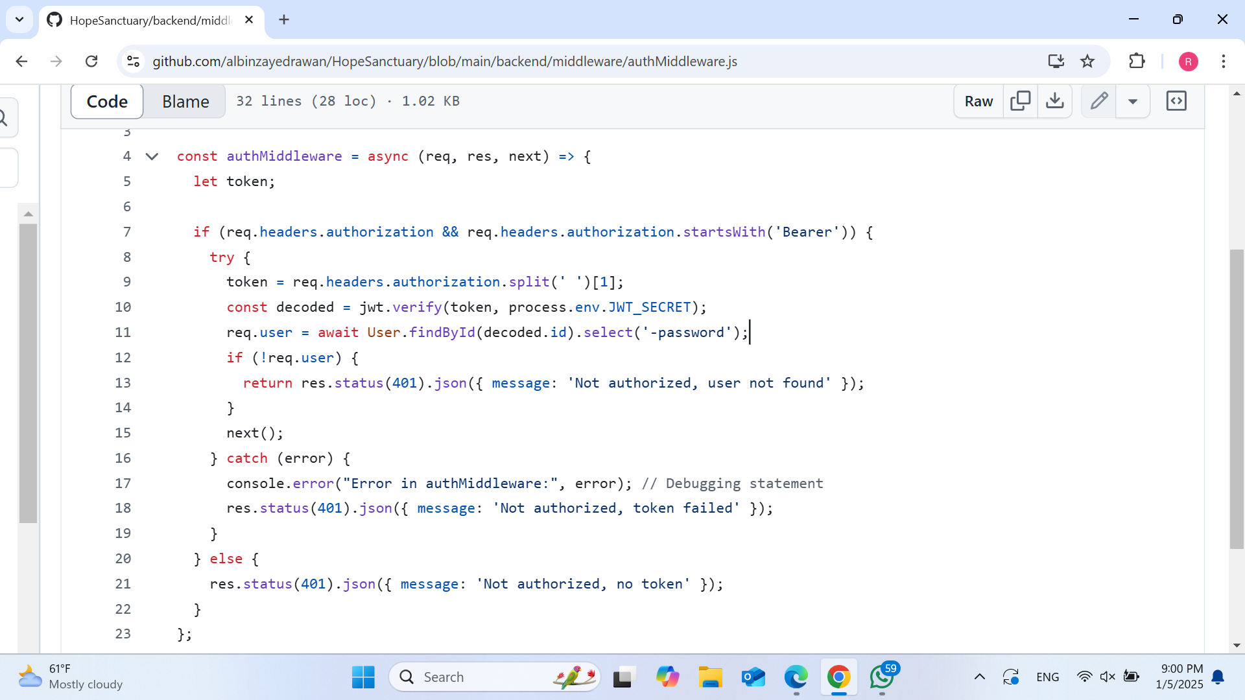
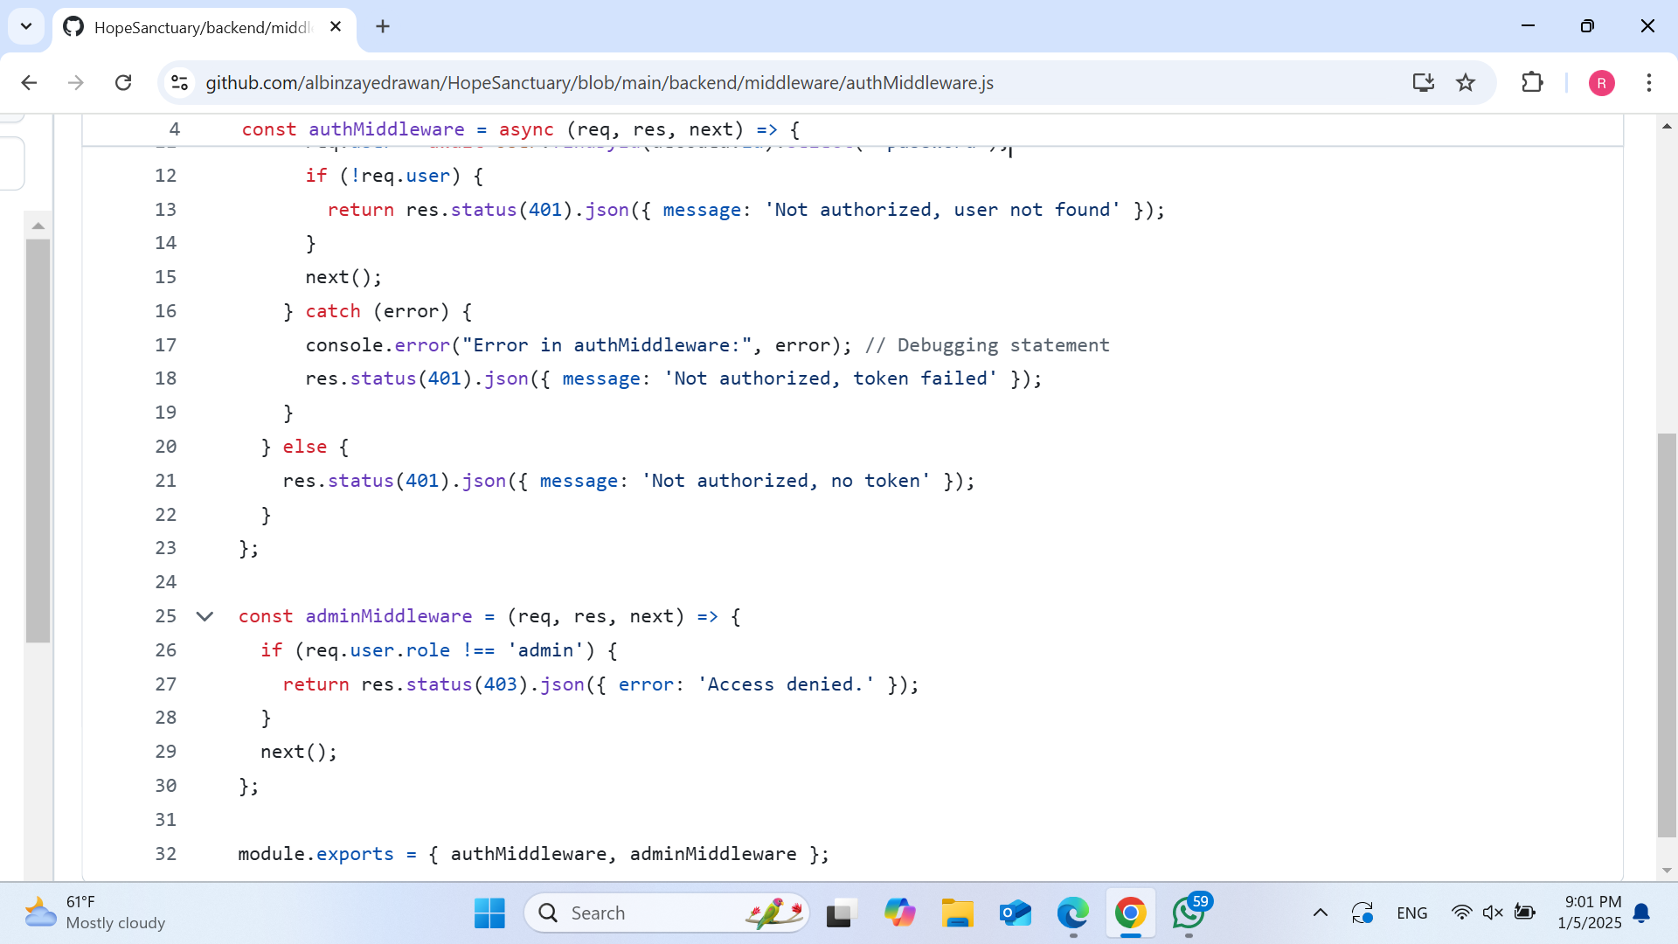
Middleware Code authMiddleware.js

Slide 19
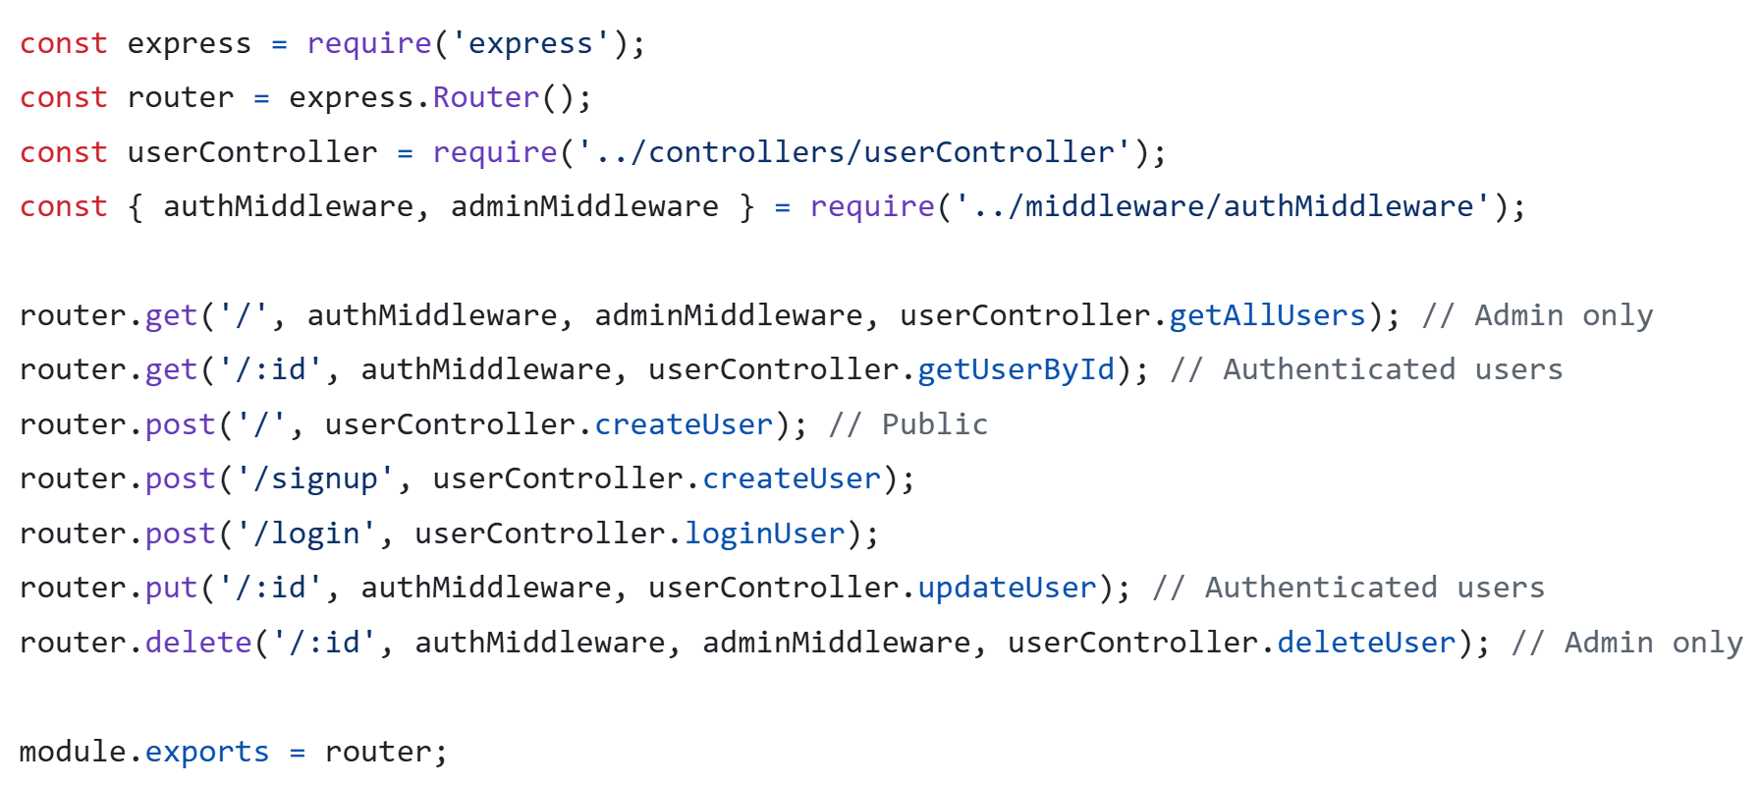
Routes Code userRoutes.js

Slide 20
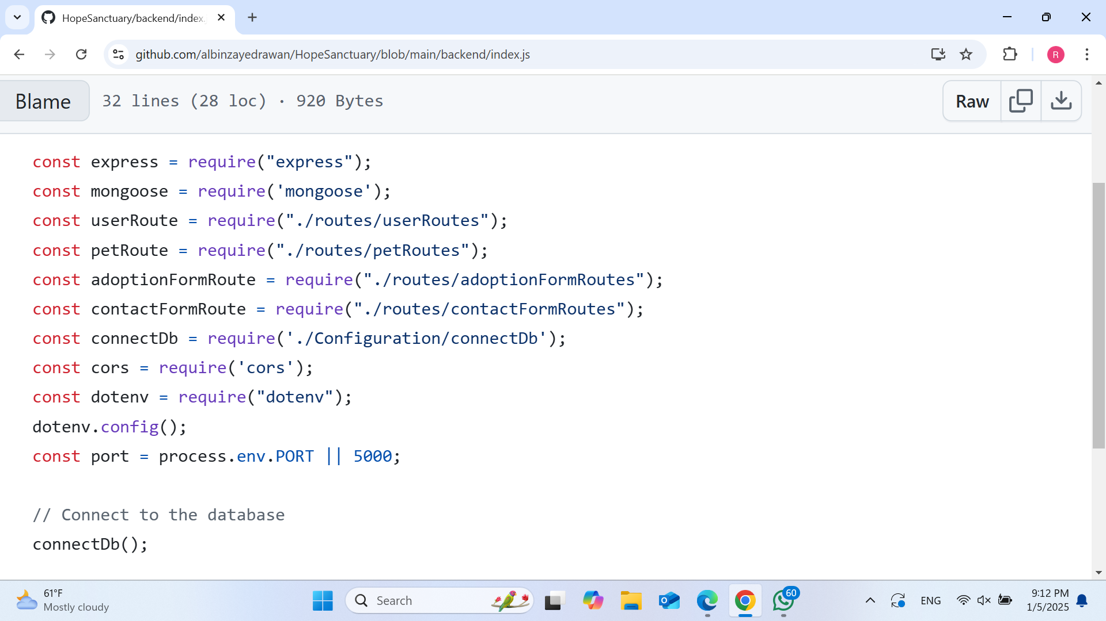
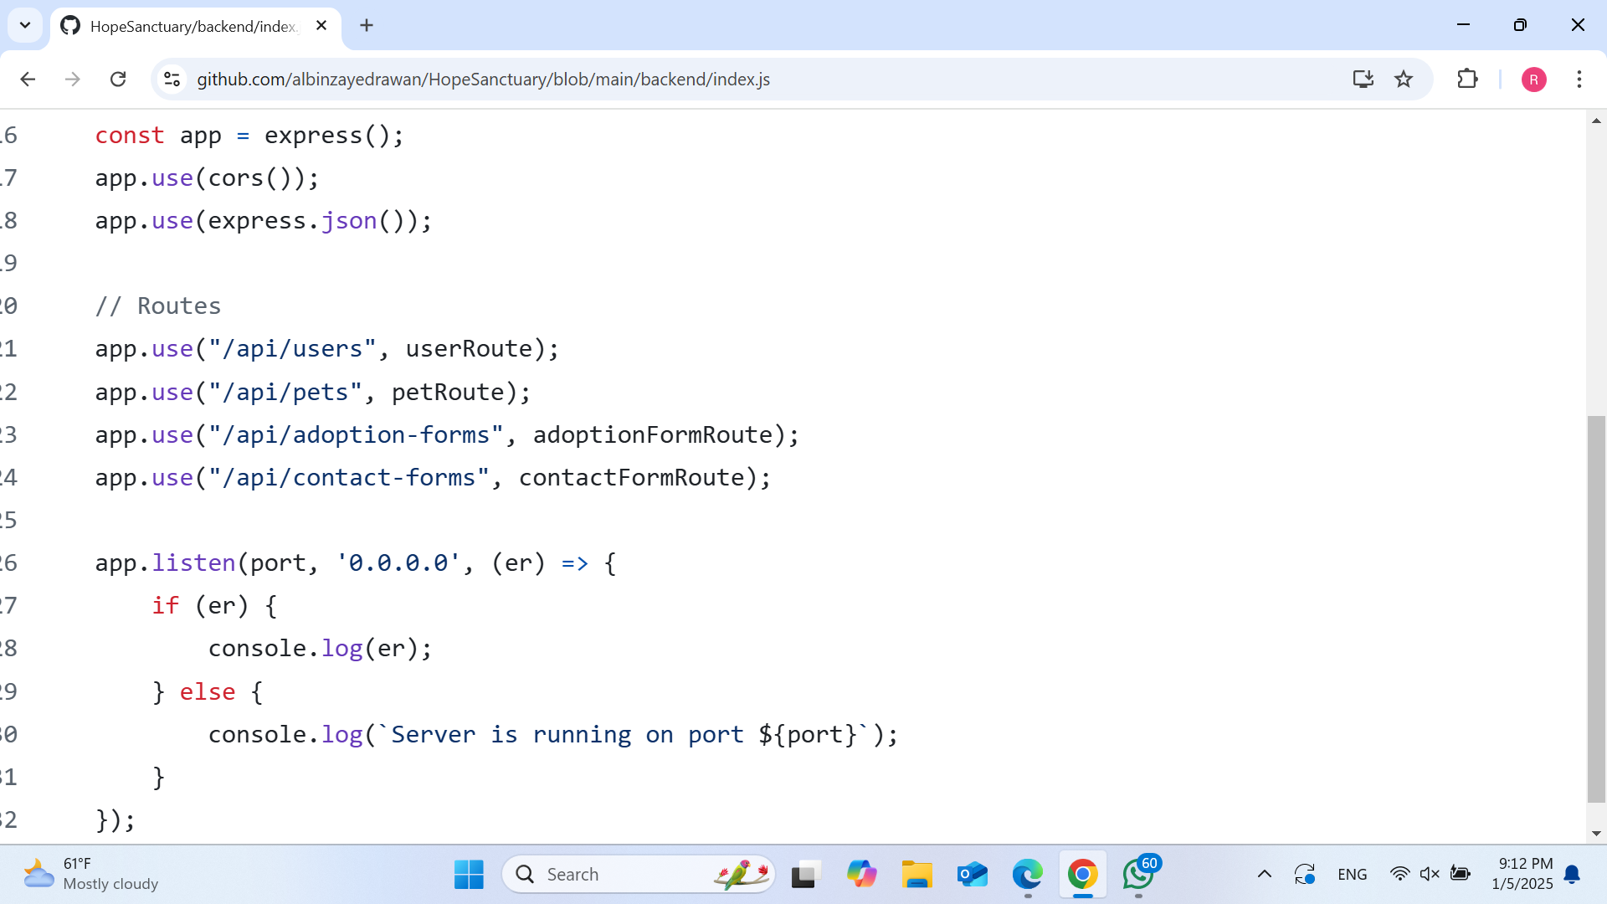
Index Code index.js

Slide 21
Unit Testing
it('should save the contact form data and return success', async () => {
ContactForm.prototype.save = jest.fn().mockResolvedValue(req.body); // Mock the save method
await contactFormController.createContactForm(req, res);
expect(res.status).toHaveBeenCalledWith(201);
expect(res.json).toHaveBeenCalledWith(req.body);
});
it('should return 400 if saving fails', async () => {
ContactForm.prototype.save = jest.fn().mockRejectedValue(new Error('Failed to save'));
await contactFormController.createContactForm(req, res);
expect(res.status).toHaveBeenCalledWith(400);
expect(res.json).toHaveBeenCalledWith({ message: 'Failed to save' });
});
});
const contactFormController = require('../contactFormController');
const ContactForm = require('../../models/contactFormModel');
// Mock the ContactForm model
jest.mock('../../models/contactFormModel');
describe('Contact Form Controller', () => {
let req, res;
beforeEach(() => {
req = { body: { name: 'John Doe', email: 'john@example.com', message: 'Hello' } };
res = {
status: jest.fn().mockReturnThis(),
json: jest.fn(),
};
});
afterEach(() => {
jest.clearAllMocks();
});

Slide 22
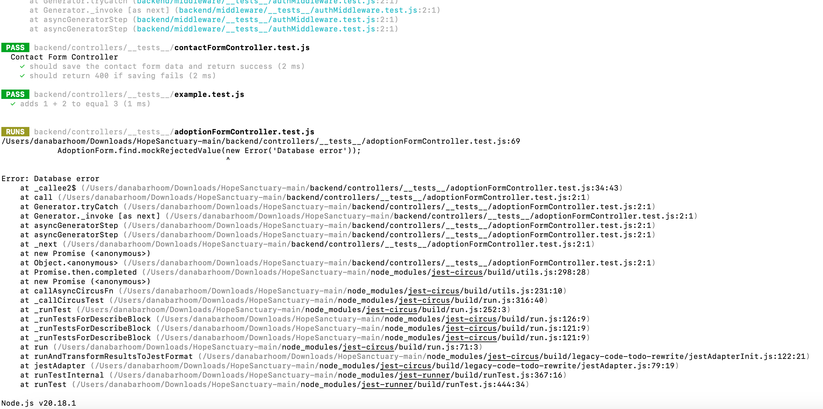
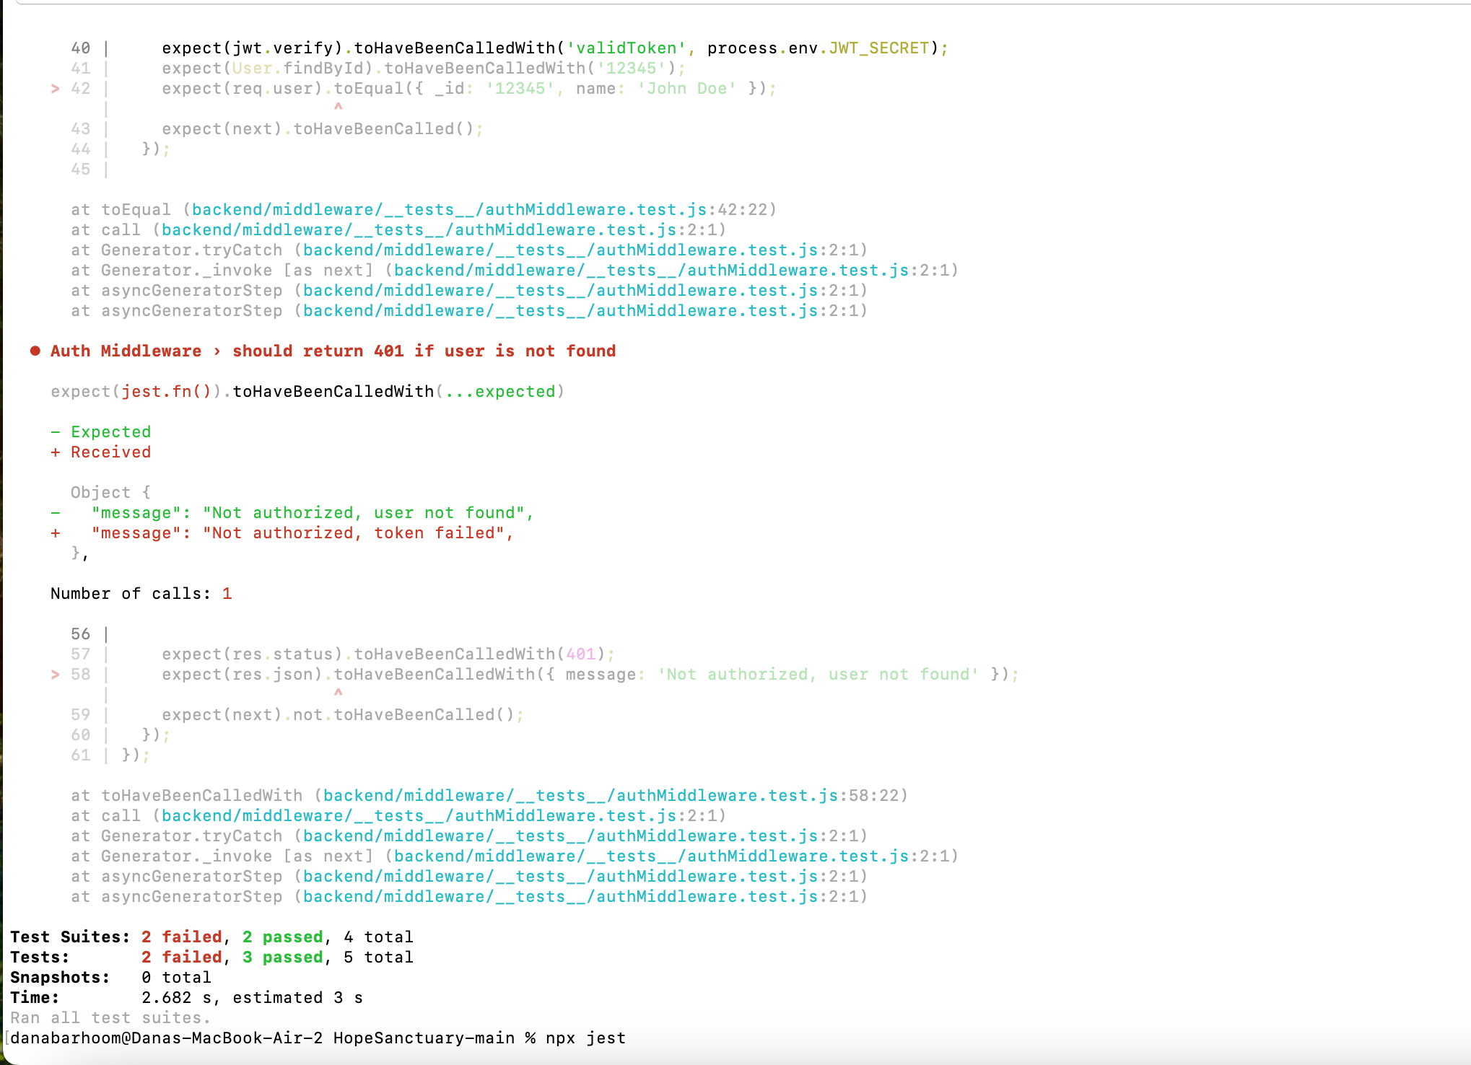
Results of Testing

Slide 23
Deployment on AWS
01
02
03
Launch EC2 Instance
Set Up Security
Connect to Server
04
05
Deploy App
Test The App
Open ports for SSH (22) and web traffic (80, 443).
Use SSH to connect:
ssh -i <key.pem> ubuntu@<IP>
Create a virtual server on AWS.
Pick an OS (Ubuntu), set security rules, and launch
Open your app in a browser and check functionality.
Copy app files, install dependencies, and start with PM2.

Slide 24
Challenges
01
Technological Learning Curve:
02
3
The team struggled to understand advanced frameworks and tools like React.js and MongoDB. Balancing learning and implementation while meeting tight timelines proved tough.
04
05
File Collaboration Issues:
Limited access to specialized equipment and expertise caused delays in development and testing.
Early on in the project, sharing and synchronizing project files resulted in inefficiencies and miscommunication between team members.
AWS Deployment Challenges:
Testing Strategies:
Due to the team's lack of past expertise with Cypress and Jest, it took significant work to understand and utilize these testing tools efficiently.
Deploying the platform on AWS required resolving server configuration challenges, handling scaling needs, and debugging connectivity issues.

Slide 25
Solutions
01
Technical upskilling:
02
3
The team used online tutorials, documentation, and knowledge-sharing meetings to swiftly learn new technologies such as React.js and MongoDB.
04
05
Efficient Resource Management:
GitHub Use:
A centralized GitHub repository was implemented, enabling seamless version control, efficient code reviews, and collaborative updates.
Prioritizing tasks and using open-source tools helped to reduce resource restrictions while preserving quality.
AWS Deployment Optimization:
Robust Testing Approach:
The team used Cypress for automated end-to-end testing and Jest for unit testing to ensure platform resilience. Regular testing cycles detected and fixed issues before they became problems.
Problems were overcome by fine-tuning server configurations, utilizing AWS Elastic Beanstalk for scalability, and doing rigorous troubleshooting of deployment problems.

Slide 26
Contribution
Means of Communication:
WhatsApp Group
Work Uploads:
GitHub
Prototyping | Rawan, Noor, Dana
HTML/CSS | Dana
Authentificaton | Noor
Frontend | Dana/Noor
API | Noor
Testing | Dana
React | Dana
Routing | Noor
Backend | Rawan
Deployment | Rawan

Slide 27
Live Demo
http://34.234.116.129:5000/

Slide 28
Thank you!
Do you have any questions?

